Slide 1
Intro to Relational Schema
Normalization
Referential Integrity (PK-FK)

Slide 2
What problem are we trying to solve?
ERD/EERD
Tables

Slide 3
What problem are we trying to solve: How do we go from ERD to Tables?
?
ERD/EERD
Tables

Slide 4
What problem are we trying to solve: How do we go from ERD to Tables? Answer: Relational Schema (RS)
ERD/EERD
RS
Tables

Slide 5
What is Relational Schema?
Converting, Transitioning, Mapping entities and their relationships to logical design (schema).
Just remember to go step by step and you will be fine.

Slide 6
DDL: Phase 1 Design, Phase 2 Build
ERD, EERD
Relational Schema
Keys (PK, FK, UN), candidate/alternate, composite (CPK)
Normalization (1st, 2nd, 3rd, Codd, 4th, 5th)
Data Dictionary
Create Tables, Views
SPROCs, Rules, Defaults, Triggers, Checks, Indexes
SQL queries, complex queries, joins
Reports using SSRS

Slide 7
4 Simple Rules to Remember for design:
Multivalued – Break out to a new table. PK becomes FK linking to PK of original table. New table still needs its own PK which will be the CPK of FK and the multivalued attribute.
Many to Many –PKs become the FKs in NEW linking table.
One to many – PK of one becomes FK in many.
One to One – PK of mandatory becomes FK in optional.
If both mandatory, either table can receive the FK.
If both optional, FK in table with fewest rows.

Slide 8
Entities and their relations, become tables and their relational arrows. The FK points back to the PK
We call this “REFERENTIAL INTEGRITY”
This
This
to
Notice how this starts to look like the header row of a spreadsheet table?

Slide 9
Acme Example: From this…
Dependent entity
Associate entity

Slide 10
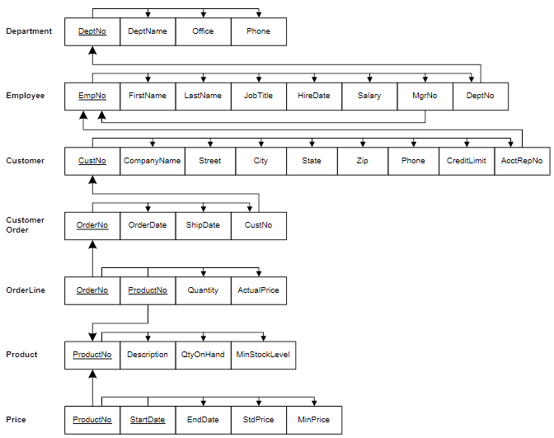
To this…
Linking Table
Join
Bridge

Slide 11
Detailed Application

Slide 12
Transforming ERDs into Schemas – “Mapping” THIS STARTS NORMALIZATION (1st form)
Step 1: Map Regular Entities to Tables…
Compound Attributes: Break into simple attributes.
Multivalued Attributes: Break out to separate table with a foreign key referencing the primary key of the table with original entity.
(leads to composite primary key (CPK) of the two attributes).
Derived Attributes: Are included in a (RS) relational schema if a calculated column is used to store the value.
( a derived value is not included in the RS is the represented data is not stored, and only calculated as needed – for example in the select statement query).

Slide 13
Mapping a Compound Attribute
CUSTOMER entity with Address compound attribute
Customer table with simple attributes

Slide 14
Mapping a Multivalued Attribute
EMPLOYEE entity with Skill multivalued attribute
(b) Two resulting tables
Note the CPK in this table.

Slide 15
Transforming ERDs into Schemas – “Mapping” THIS IS THE REASON CARDINALITY and OPTIONALITY MATTERS
Step 2: Map Binary Relationships
One-to-Many: Primary key on the one side becomes a foreign key on the many side.
Many-to-Many: Break out to new table (association entity);
the primary key of the new table is typically a CPK comprised of the primary keys of the tables from the two entities involved in the relationship.
One-to-One: Primary key on the mandatory side becomes a foreign key on the optional side.
If optionalities are both mandatory, either table can receive the FK.
If optionalities are both optional, place FK in table with fewest items (columns).

Slide 16
Mapping a Binary 1:M Relationship
Relationship between CUSTOMER and ORDER (1:M)
Two resulting tables
Referential integrity arrow used to show the linkages between the tables.
Connects the FK of one table to the related PK of another table.

Slide 17
Mapping a Binary M:M Relationship
Notice the data intersection
Three resulting tables
Notice the CPK of the associative table linking to the originating tables

Slide 18
Mapping a Binary M:M Relationship (continued)
one DateAssigned value per Employee-to-Project assignment (the Date-Assigned is the Assignment start date):
more than one DateAssigned value per Employee-to-Project assignment (a DateAssigned value for each day worked) – requires unique for each entry:
two-column CPK.
three-column CPK.

Slide 19
Mapping a Unary 1:M Relationship
(Compare to Refs)
Employee table with recursive foreign key
Where did this column come from?
What is a synonym?
Note mandatory use of synonym for FK.

Slide 20
Employee example as a table
PK
FK
EmployeeID | FirstName | LastName | DateOfBirth | ManagerID
137 | John | Doe | 03/15/1980
142 | Mary | Brown | 05/16/1982 | 137
170 | George | Turner | 11/04/1969 | 137
186 | Stephen | Smith | 09/17/1978 | 142
198 | Amanda | Walters | 12/17/1984 | 170
204 | Ernest | Hodges | 08/29/1972 | 137
267 | Michael | Rogers | 01/02/1985 | 170
285 | Juan | Rodriguez | 10/10/1968 | 137
323 | Kevin | McFadden | 11/11/1977 | 142
361 | Charles | Robideaux | 02/28/1980 | 142
Requires a column in the table to act as a recursive foreign key referencing the primary key of the table.

Slide 21
Mapping a Ternary Relationship
Notice Relation and Data Intersection is an associative entity here
Four resulting tables
Note the CPK of the associative table (linking table).
Remember that the CPK must represent a unique set of values.

Slide 22
Functional Dependency 2nd Normal Form
Relational tables

Slide 23
Functional Dependency 2nd Normal Form
Functional attributes

Slide 24
Functional Dependency 2nd Normal Form
Relational tables
Functional attributes

Slide 25
Examples for you to Practice with

Slide 26
From This…

Slide 27
To this…
functional dependency arrows along the tops of the tables

Slide 28
This…

Slide 29
To this…

Slide 30
This…

Slide 31
To this…

Slide 32
Walkthrough:

Slide 33
What you should know by now:
Entities, attributes, tables.
ERD, relationships, cardinality, optionality.
Relational Schema, PK, FK, CPK, Candidate, Alternate
1st normal form.
2nd normal form.

